Slide 1
State of the Art analysis – Indoor Navigation Systems

Slide 2
Some general references
2410.19954
Towards a Method for LLM-enabled Indoor Navigation (Arxiv) This work was founded by European Union - Next Generation EU, in the context of The National Recovery and Resilience Plan, Investment Partenariato Esteso PE8 ”Conseguenze e sfide dell’invecchiamento”, Project Age-IT, CUP: B83C22004880006
Toward Assisting Blind Individuals in Exploring Unfamiliar Indoor Environments Using Multimodal LLM and Smartphone LiDAR | IEEE Conference Publication | IEEE Xplore
LLMs-Enhanced Multi-Modal Navigation in UAV Systems

Slide 3
Something about OpenCV
"We could create a system based on the use of Computer Vision.
Pros:
Open source and well-documented: OpenCV: OpenCV Tutorials
Not a very recent technology, so it's likely we'll find other usage examples
Cons:
In my opinion, the implementation is very complex; we would have to develop all the 'surrounding components' ourselves"

Slide 4
Emulating the app Magnifier
"Alternatively, we could try to 'emulate' the functionality of the Lens app.
Pros:
There are several well-structured frameworks we could leverage, including:
AVFoundation for camera access and real-time image analysis (AVFoundation Overview - Apple Developer)
Vision Framework for text and object recognition (Apple Vision Framework: Full Guide With Hands-On Examples)
Core ML for using machine learning models for environmental recognition (Core ML Overview - Machine Learning - Apple Developer)
ARKit for possible integration of augmented reality to enhance user experience without visual obstruction (ARKit 6 - Augmented Reality - Apple Developer)
AI Voiceover for accessibility features (How to Create AI Voice Over Videos using an API – Creatomate)
Or, more simply, we could use a RAG (Retrieval-Augmented Generation) with a multimodal LLM, although in this case too we’d still need to develop the frontend, etc. (MultiModal RAG for Advanced Video Processing with LlamaIndex & LanceDB | by Raghav Dixit | LlamaIndex Blog | Medium)
Cons:
There are quite a few things we need to study and evaluate to see if they suit our needs."

Slide 5
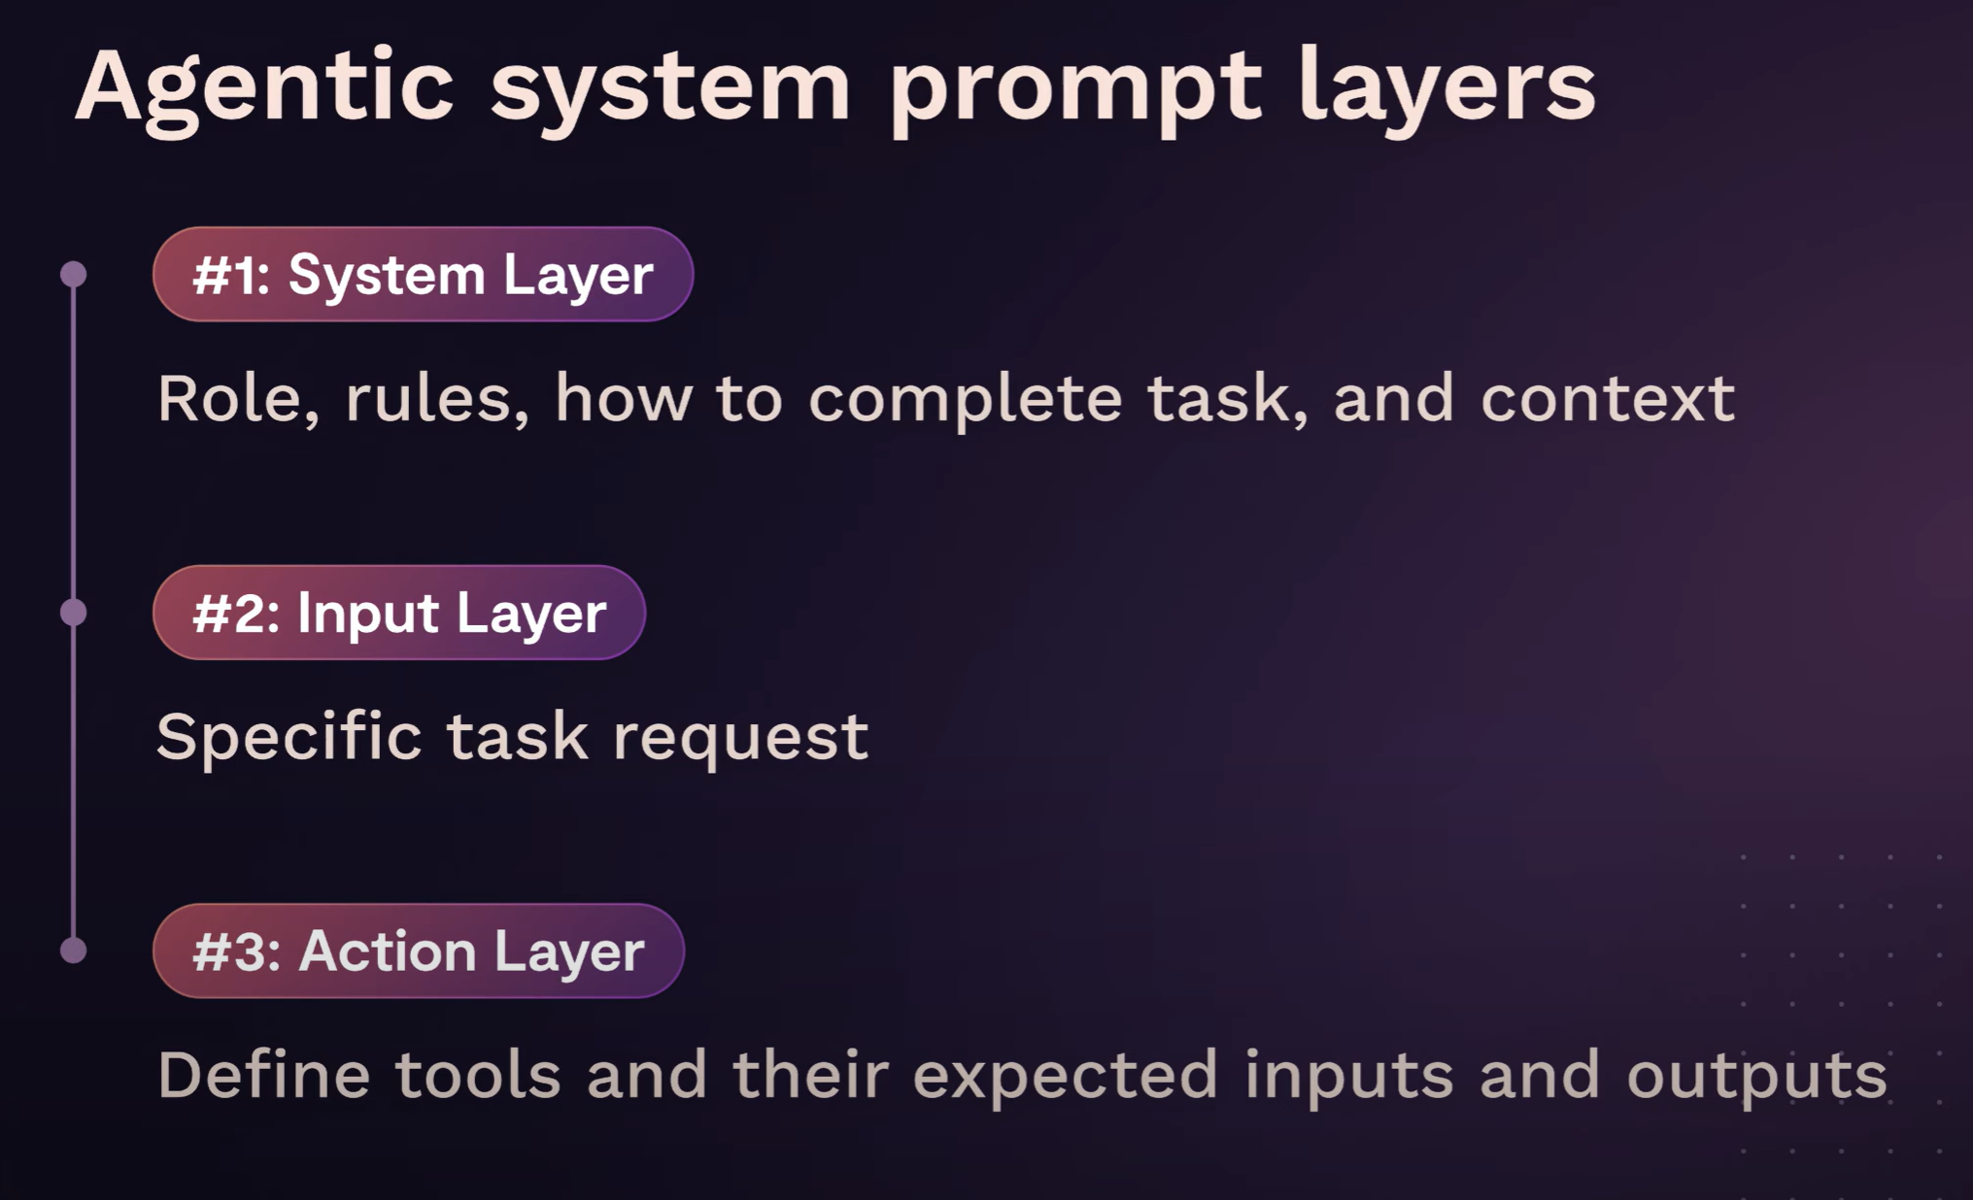

Slide 6
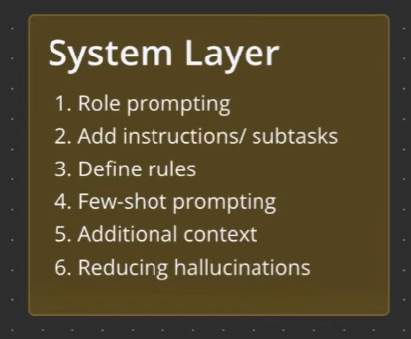

HOW TO: SYSTEM PROMPT
#Role
You are an indoor navigation system that helps blind people navigate inside University Campus.
Your role is to give context awareness and directions to reach specified destinations.
#Instructions (Here it’s possible to specify which tool to use)
Follow the following steps to give context awareness and navigations directions
1. Search inside the documentation for the user’s selected destination. If you find it, go on with your instructions, otherwise, write an error message
2. Analyze the images that you are receiving. They are real-time recorded by the user. You need to extract the relevant information for the navigation, such as object that may disturb visually impaired people, crowd, cartels and point of interest such as classroom, bathroom, vending machines.
3. Compare the images with the documentation you are provided to understand the user’s positioning inside the campus
4. Give instructions to reach the destinations, based on the user’s positioning(Tool specifico qui?).

Slide 7
HOW TO: SYSTEM PROMPT
#Rules
-Always give spatial distance when providing context awareness information
-Don’t make things up, provide only the information about the environment that you can extract from analyzing the user’s recorded images

Slide 8
HOW TO: SYSTEM PROMPT
The answers could be structured as provided examples or as a JSON schema
#Examples
Use the following examples when you need to extract the relevant information for the navigation, such as object that may disturb visually impaired people, crowd, cartels and point of interest such as classroom, bathroom, vending machines.
<examples>
<example>
Vending machines 100 meters in front on you
</example>
<example>
Cartel saying “Classroom T.0.2” 300 meters on you right
</example>
<example>
Very crowded hallway in front of you
</example>
<example>
Tables in the corridor in front of you
</example>
</examples>

Slide 9
HOW TO: SYSTEM PROMPT
#Additional context
The user is navigating inside the Politecnico Campus
The users can be fully blinded to low vision

Slide 10
HOW TO: SYSTEM PROMPT
Reducing hallucinations
To reduce hallucinations, we need to give the Agent an “escape”, so for example allowing it to say “I don’t know”, otherwise it will keep trying to help us.
#Rules
-Always give spatial distance when providing context awareness information
-Don’t make things up, provide only the information about the environment that you can extract from analyzing the user’s recorded images
-If you can’t figure out how to reach the destination provided by the user, display an error message

Slide 11
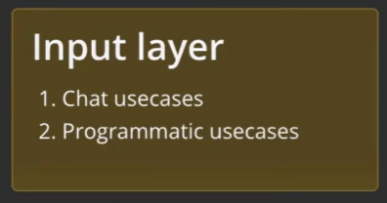
HOW TO:
USER PROMPT
What are the possible inputs?
The users can be both a human or, for example, another agent or an API. We need to correctly set that in our pipeline of work

Slide 12
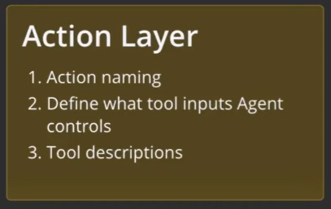
HOW TO:
ACTION LAYER
Tools
Some operations needs to be performed by external tools (function), for example we could write an algorithm or something else to give navigation direction. We need those tools to be correctly triggered by our Agent.
Typically, an embedder is needed to do the parsing between the user’s request and the tool description. In our architecture, the tool could be directly triggered by the app interface.

Slide 13
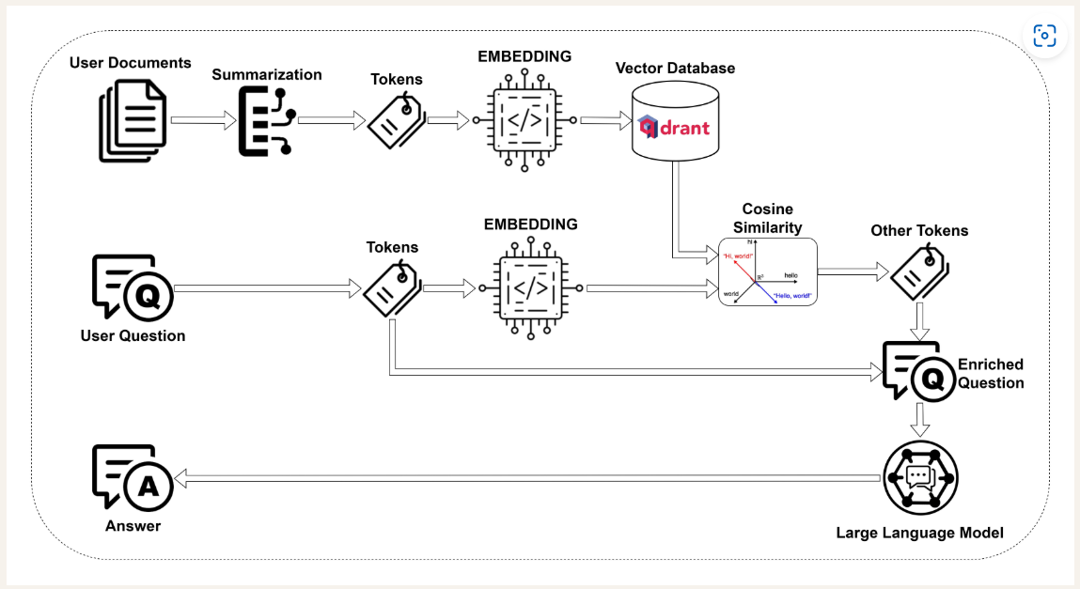
An example: the Cheshire Cat AI
The workflow:

Slide 14
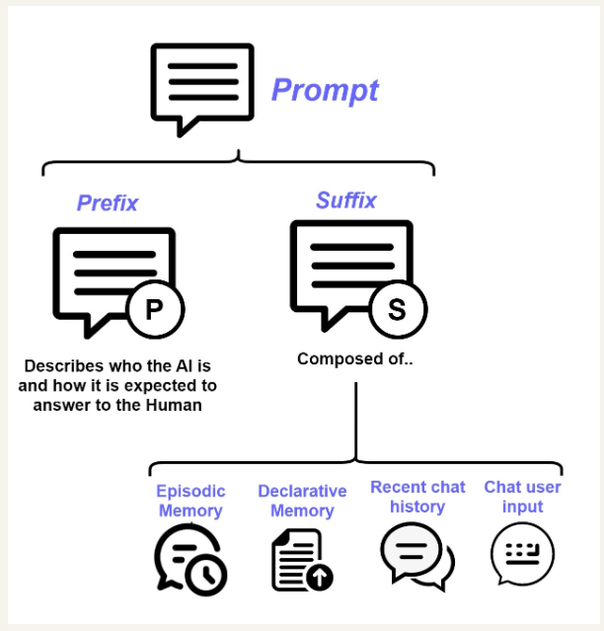
An example: the Cheshire Cat AI
The prompt:

Slide 15
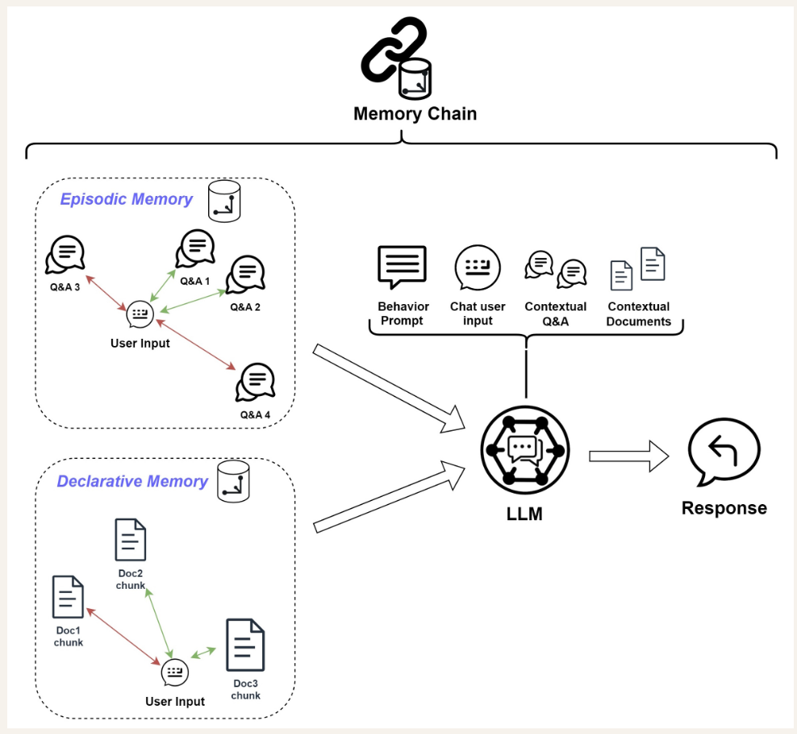
An example: the Cheshire Cat AI
The memory chain:

Slide 16
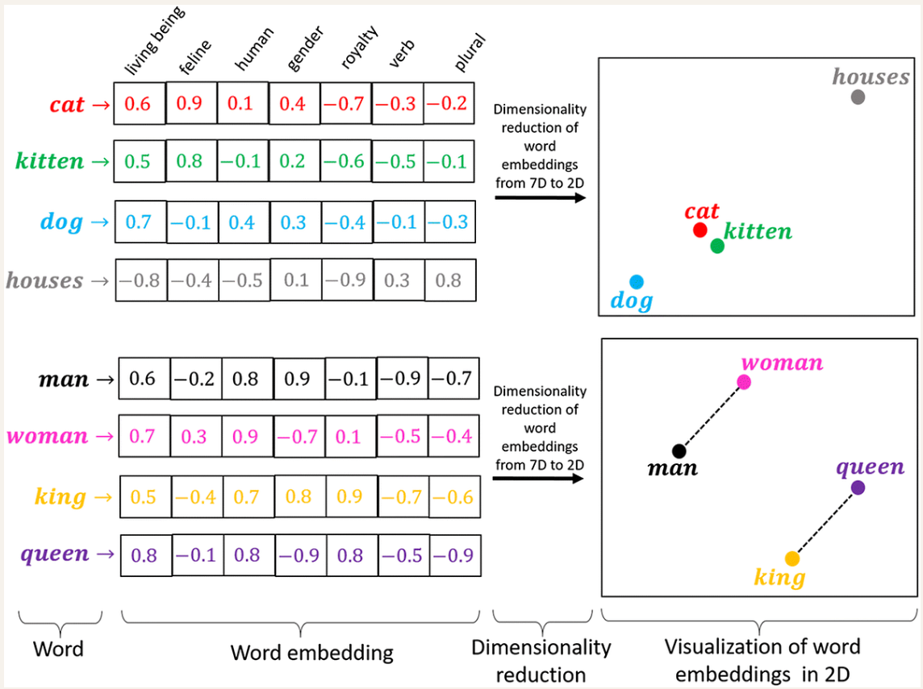
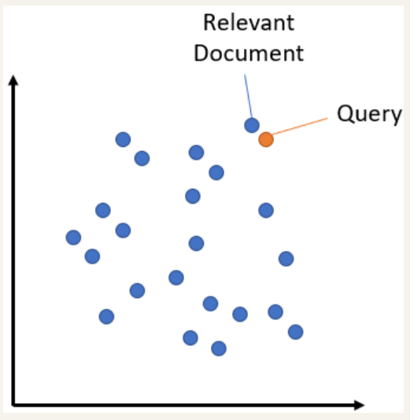
An example: the Cheshire Cat AI
The Vector Store:

Slide 17
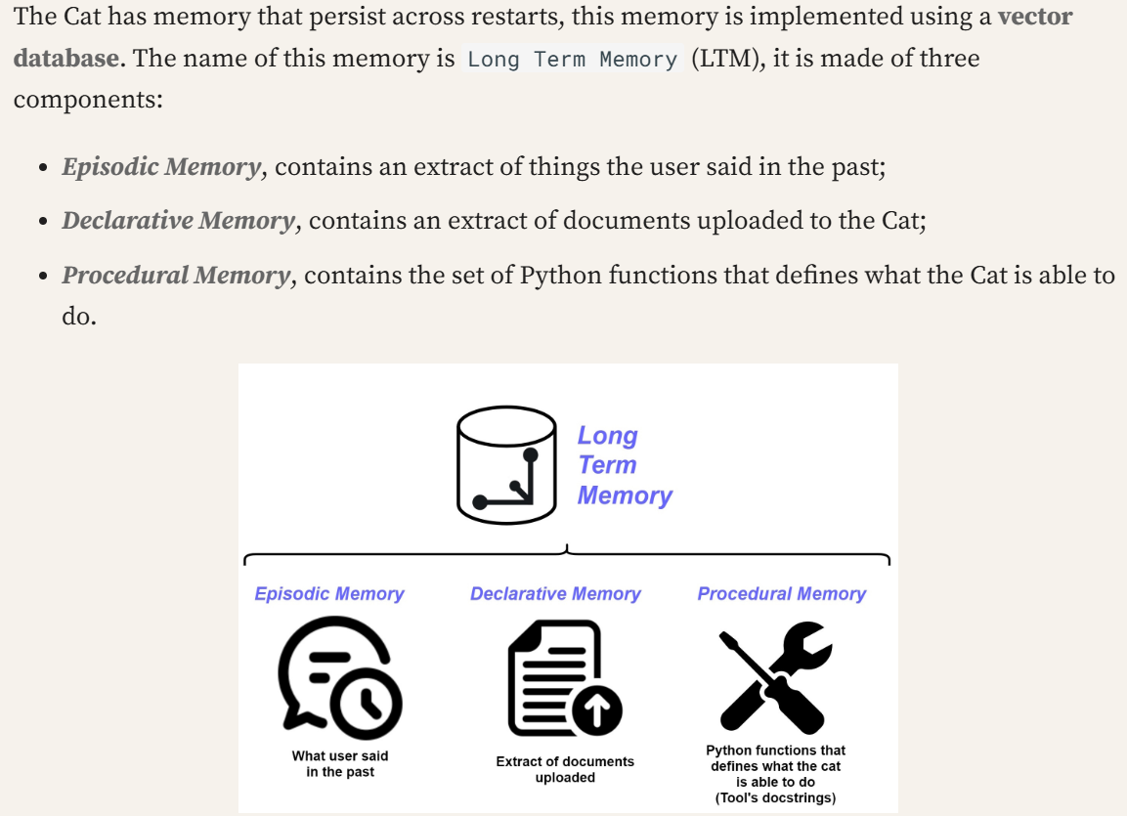
An example: the Cheshire Cat AI
The Long Term Memory:

